Slide 1
FACE RECOGNITION ATTENDANCE SYSTEM
DEVELOPED BY
Mr. S.RIYAZ AHAMED,B.E.,
Department of Computer Science and Engineering

Slide 2
OBJECTIVE
The purpose of this project is to build a human face recognition to mark the attendance.

Slide 3
INTRODUCTION
Recognition of the human face is an active issue for authentication purposes specifically in the context of attendance of students.
Attendance system using face recognition is a procedure of recognizing students by using face biostatistics based on the high definition camera and other computer technologies.

Slide 4
EXISTING SYSTEMS
Fingerprint Based recognition system and its Disadvantages are Time-consuming.
RFID(Radio Frequency Identification) Based recognition system and its Disadvantages are Fraudulent usage.
Iris Based Recognition System and its Disadvantages are Privacy invasion.

Slide 5
PROPOSED SYSTEM
This system captures students' faces and stores them in a database for attendance purposes.
The system detects all facial features, including seating position and posture, to accurately identify students.
With video processing, the system automatically recognizes faces and updates the attendance database.
Eliminating the need for manual attendance taking by teachers.

Slide 6
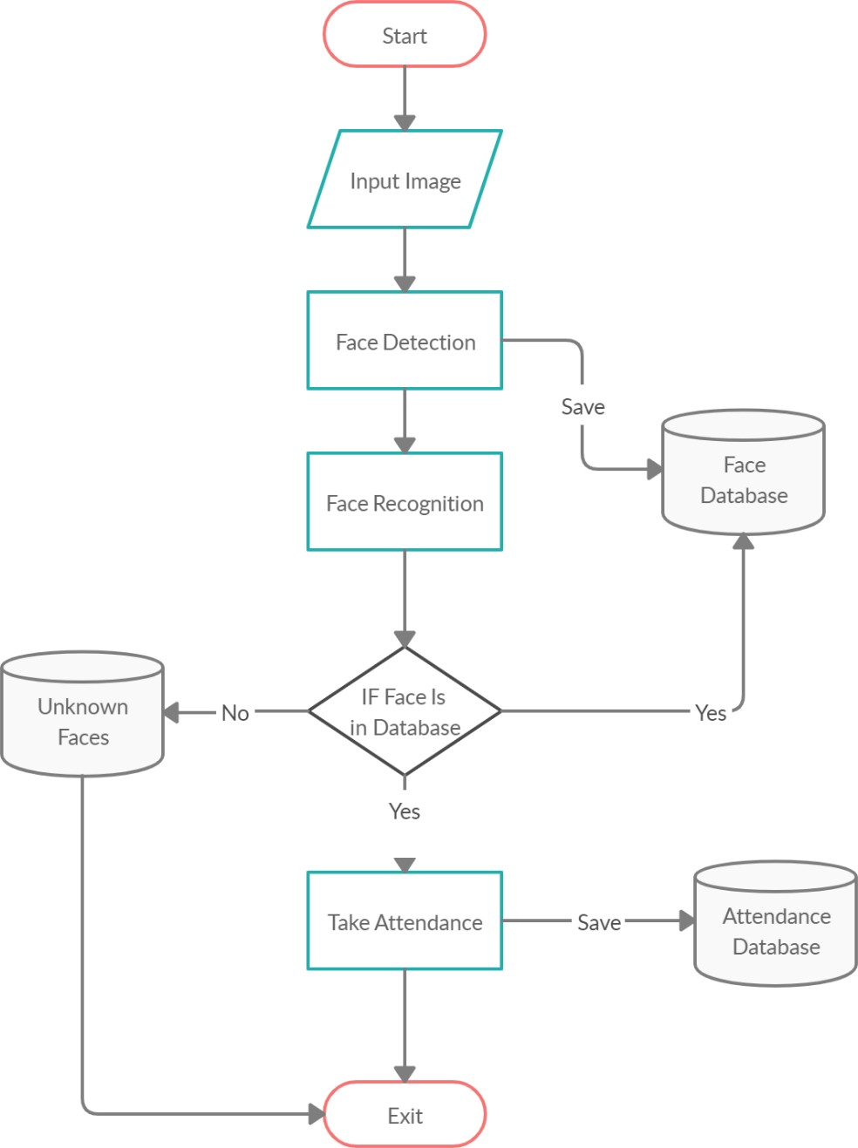
DATA FLOW DIAGRAM

Slide 7
REQUIREMENTS
SOFTWARE REQUIREMENTS :
Python (3.6 or higher)
Windows 10 or advanced version
Pycharm or VScode

Slide 8
REQUIREMENTS
HARDWARE REQUIREMENTS :
IP Camera / Web Camera
Computer with dual core processor
Min 4GB RAM
Min 1GB ROM

Slide 9
PROJECT DESCRIPTION
A facial recognition attendance system uses facial recognition technology to identify and verify a person using the person's facial features and automatically mark attendance.
The software can be used for different groups of people such as employees, students, etc.
Eliminate paperwork and save time.
The system records and stores the data in real-time.

Slide 10
MODULES
Check Camera
Capture Faces
Train Images
Recognize & Attendance
Auto Mail
Quit

Slide 11
Module Description
Check Camera :
This module is responsible for checking the availability of the camera and ensuring that it is working properly.
If the camera is not available or not functioning correctly, the system cannot capture images and recognize faces.

Slide 12
Module Description
Capture Faces :
In this module, the camera captures the images of the individuals and extracts the faces from the images.
This module is responsible for capturing high-quality images that can be used for face recognition.

Slide 13
Module Description
Train Images :
Once the images have been captured, this module trains the system to recognize the faces.
This module uses machine learning algorithms to create a face recognition model that can accurately identify individuals based on their facial features.

Slide 14
Module Description
Recognize & Attendance :
This is the core module of the system, responsible for recognizing the faces of the individuals and marking their attendance.
The system compares the captured face with the trained model and determines the identity of the individual.
It then marks the attendance and updates the attendance record in the database.

Slide 15
Module Description
Auto Mail :
This module automatically sends an email to the concerned person(s) with the attendance report.
This module eliminates the need for manual intervention, making the system more efficient.

Slide 16
Module Description
Quit :
This module allows the user to exit the system and terminate the program.
It allow convenient and controlled way to exit the application while ensuring data integrity and system stability.

Slide 17
CONCULSION
This system overcome many limitations incorporated in attendance, this system saves a great amount of time and reduces errors which may occur during attendance calculation.
The system I have developed is fully responsive which can be used in mobile, tablets and different operating systems.

Slide 18
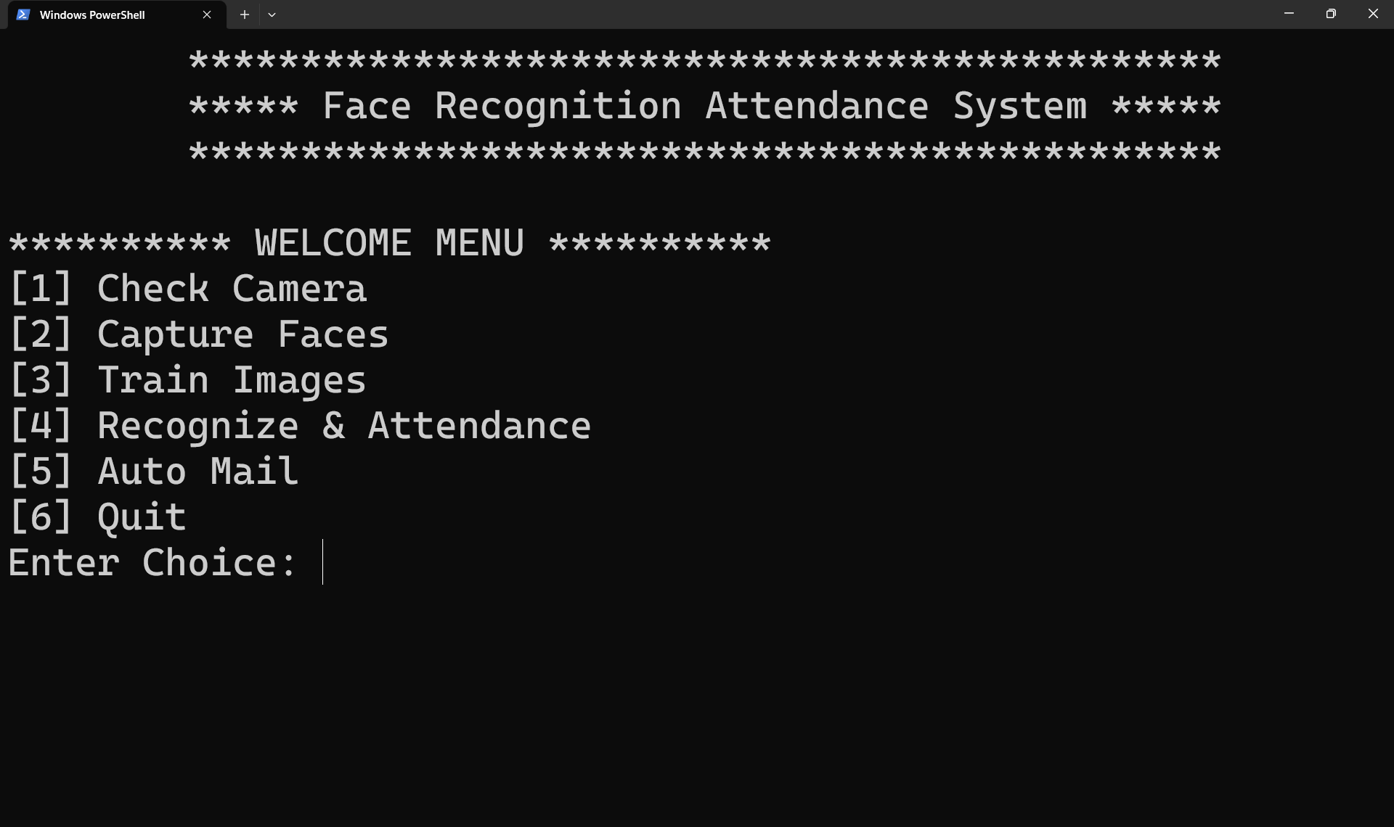
Screenshots

Slide 19
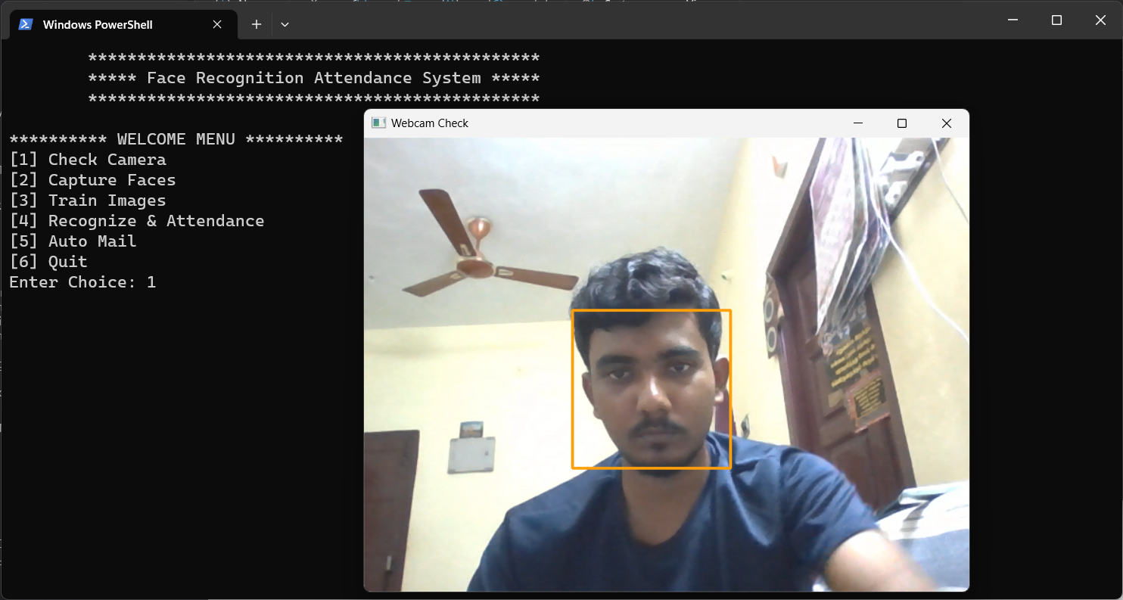
Screenshots

Slide 20
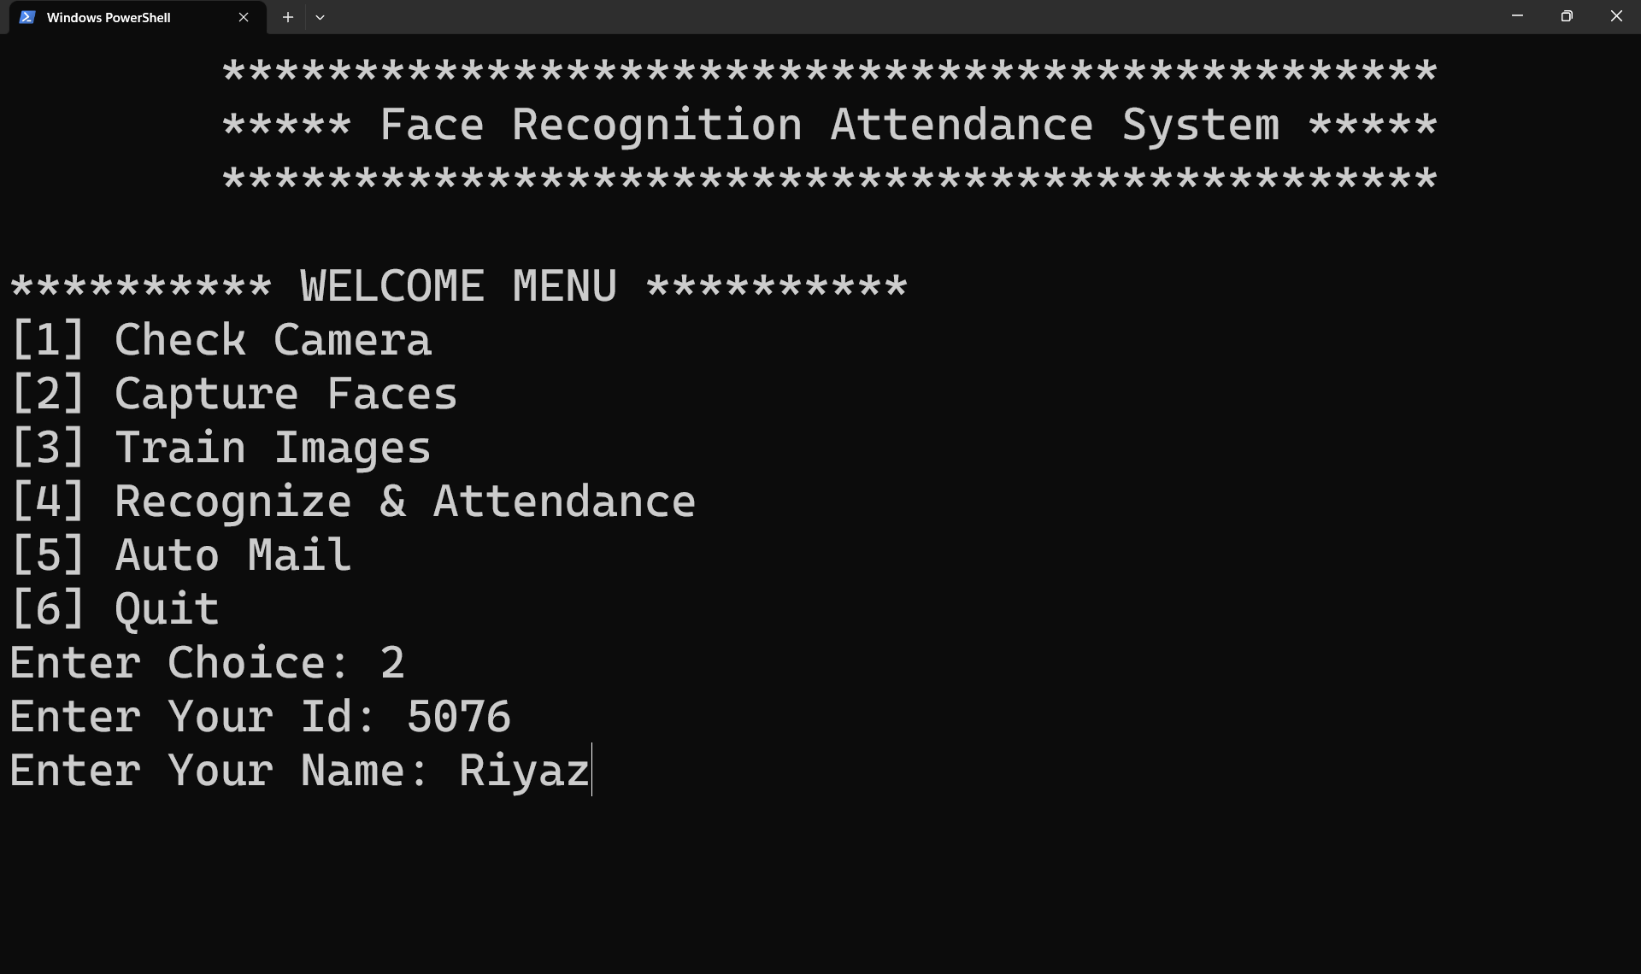
Screenshots

Slide 21
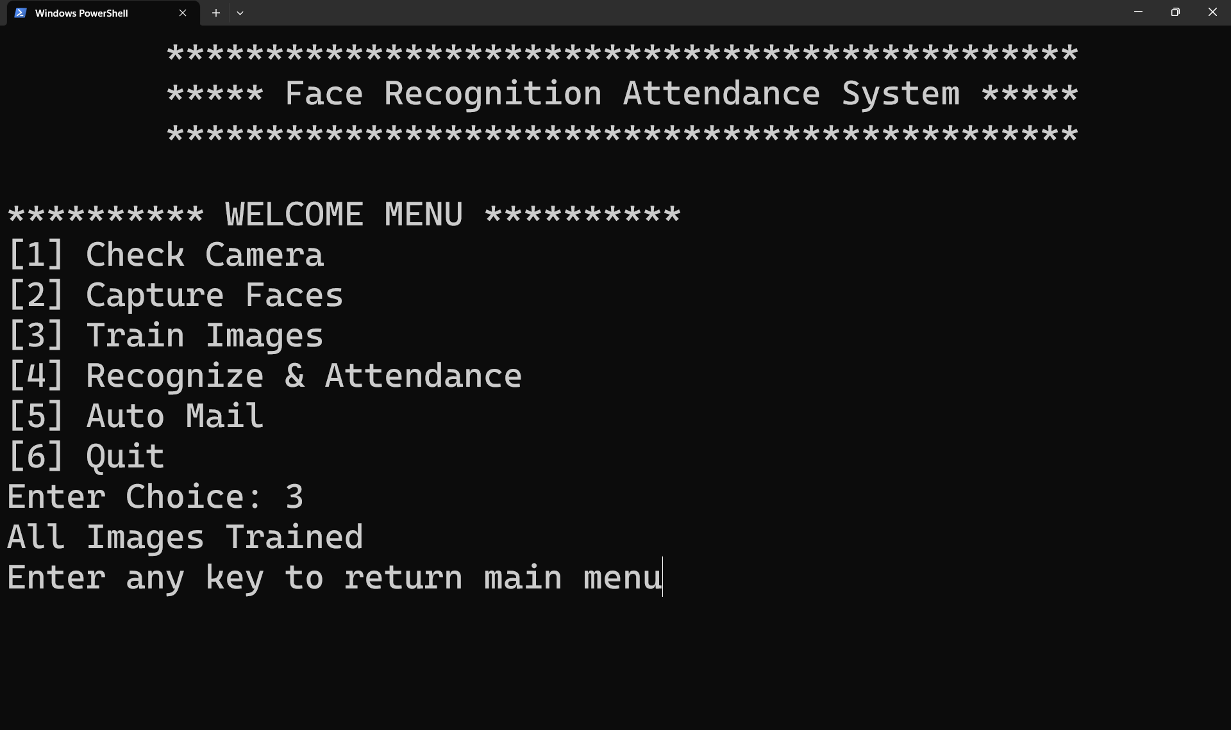
Screenshots

Slide 22
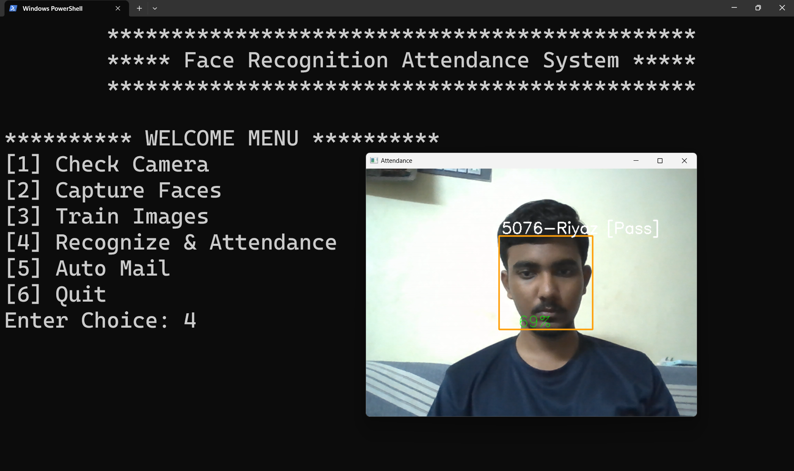
Screenshots

Slide 23
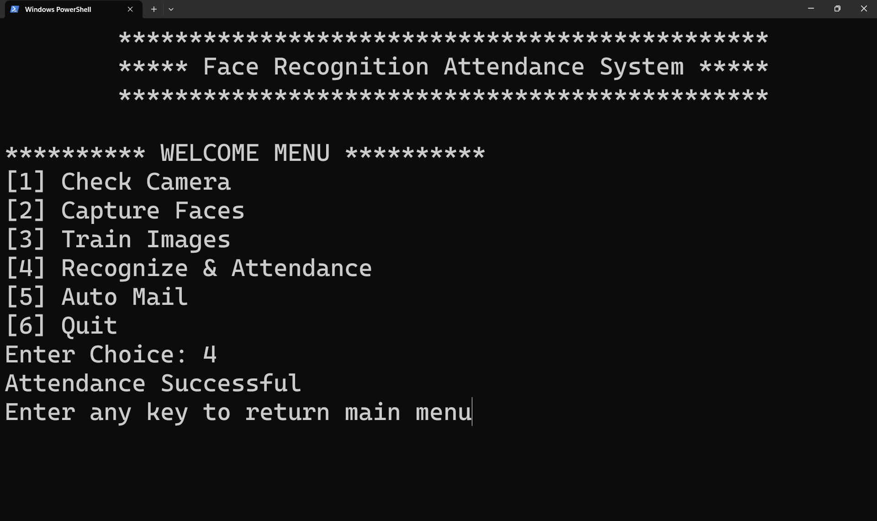
Screenshots

Slide 24
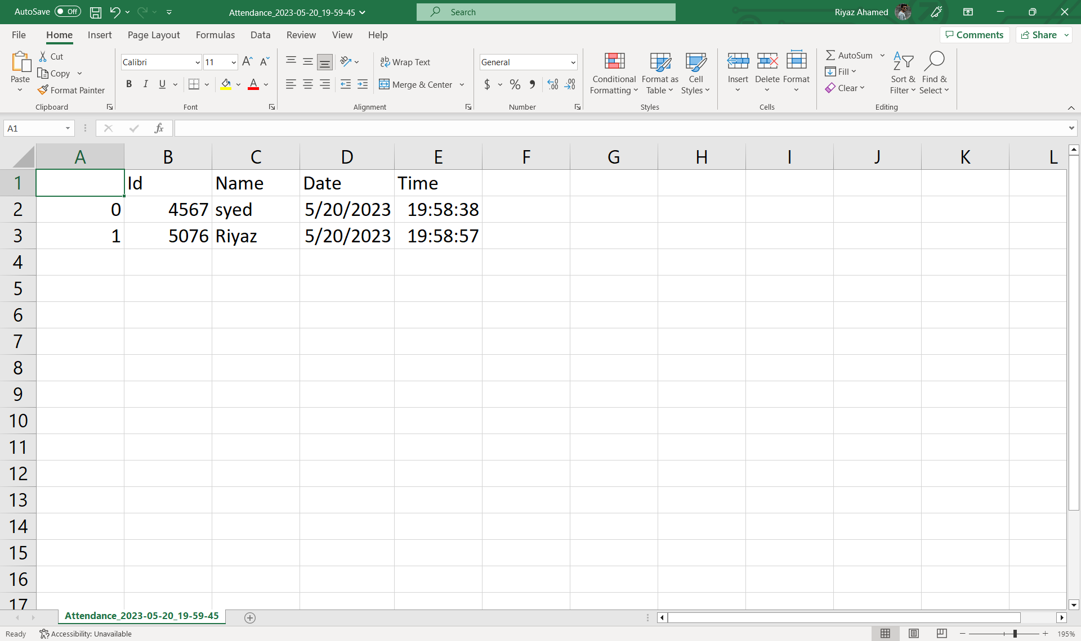
Screenshots

Slide 25
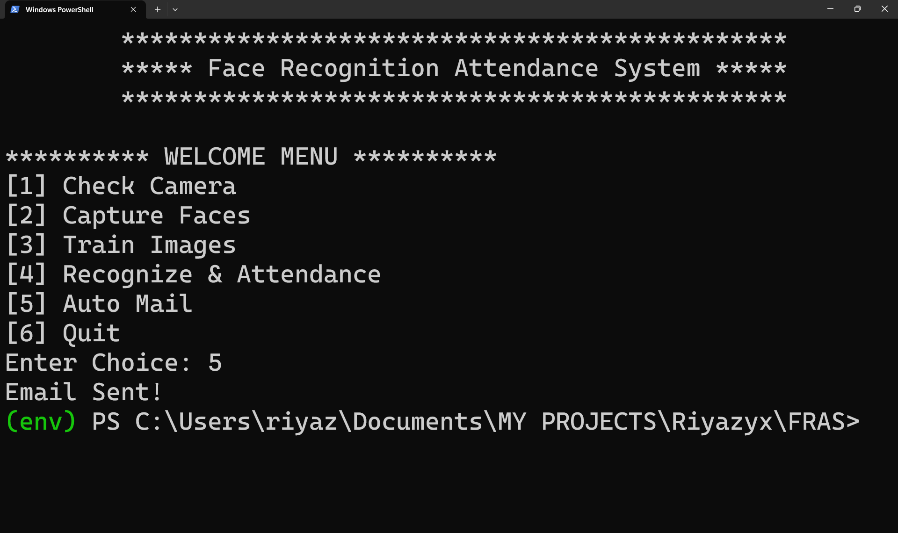
Screenshots

Slide 26
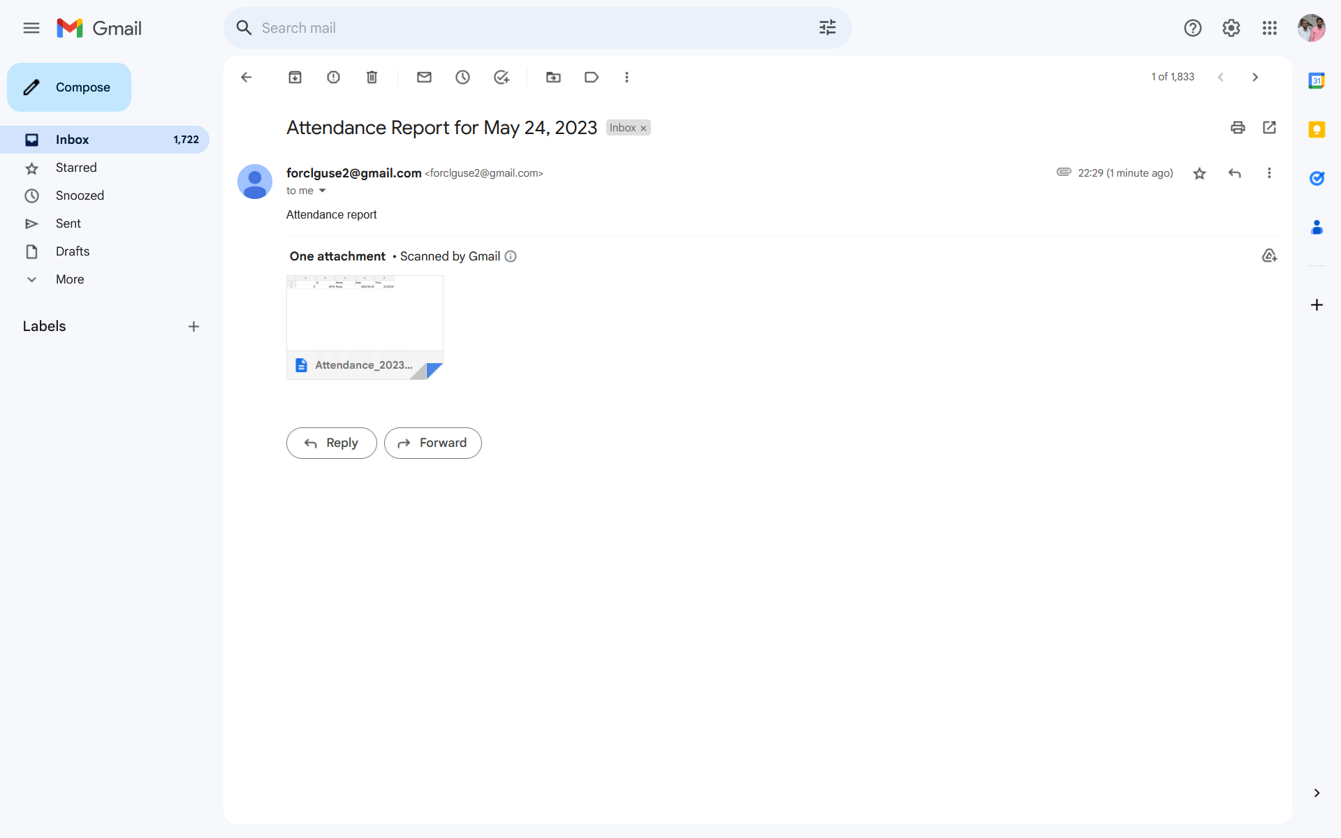
Screenshots

Slide 27
THANK YOU

